Slide 1
Specify the criteria
Who will be considered as confirmed infection:
Firstly, consider those who reported infection duration 1st and 2nd surveillance (n=766), however, only 690 of them have N_cha_S2 == “Reactive”. While the N antibody should only come from infection, they might be wrongly reported, and we label them as confirmed infection (n=544).
Secondly, consider those whose S antibody level increased but reported no infection. They might be infected but didn’t report. We label them as unconfirmed infection.
All the confirmed infection are included in our “infection vs non-infection” study as “cases”.
Now, looking for “controls”.
Firstly, those who reported infection during 1st and 2nd surveillance(n=766) and who are labelled as “unconfirmed infection”(n=544) should be excluded. Although we can not make sure they are all infected, we should exclude them anyway.
Secondly, those who didn’t attend 2nd surveillance should be excluded because they might have infections after 1st surveillance but didn’t report.
Additionally, those who have missing values at 1st or 2nd surveillance should be excluded since the next stage is based on S antibody level comparison.
Then, finally, those who didn’t have vaccination record but the S antibody level increased should be excluded.
Then, the rest of population can be considered as “controls” in our study.

Slide 2
Figure1:Step-by-step flowchart to create case-based cohort
9,945
Total amount of objects in
the 1st surveillance
Exclude those who did not attend or missing S antibody level in the 2nd survey (n = 2,423)
Exclude the population with vaccination between 1st survey and infection if had (n =22)
Exclude the population with increased S Antibody level in the 2nd survey (n = 1,207)
Put it as a exclusion
Confirmed infection
between 1st and 2nd Survey (n = 744)
No infection
between 1st and 2nd Survey (n = 5,549)
Exclude those had N- antibody at the 2nd Survey (n = 76)
Exclude the population with vaccination during 1st and 2nd Survey (n = 1,349)
Included in the Case Group :
n = 668
Included in the Control Group:
n = 4,200

Slide 3
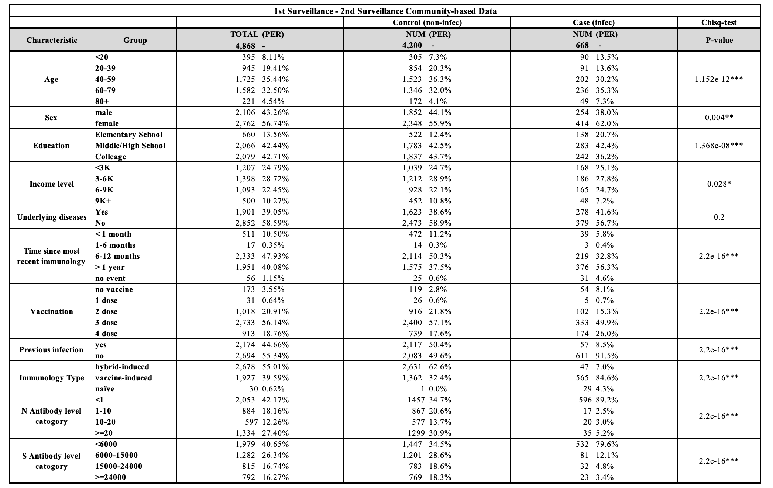
Table1: Description for case-based cohort
N antibody
category

Slide 4
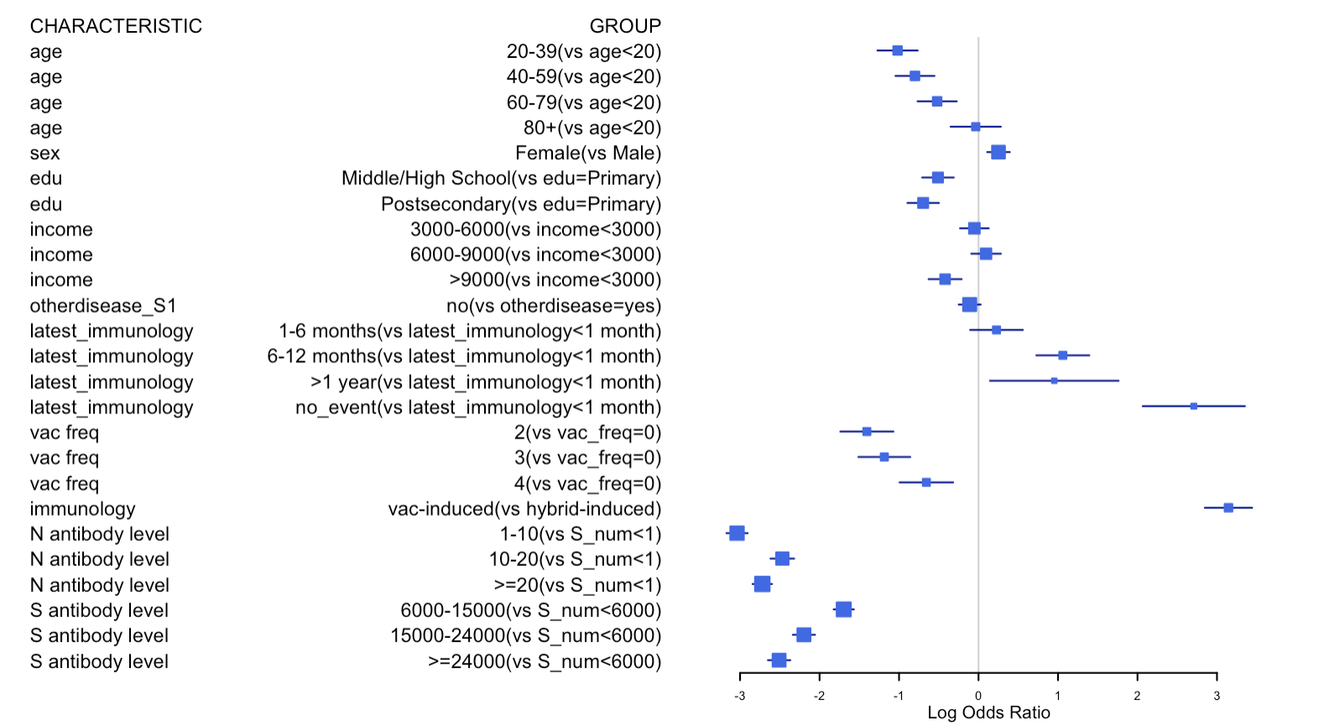
Figure2: Meta analysis with forest plot
N antibody before the
S antibody level
The risk odds of population with vac-induced is 25(e^3.2) times than the hybrid-induced ones.

Slide 5
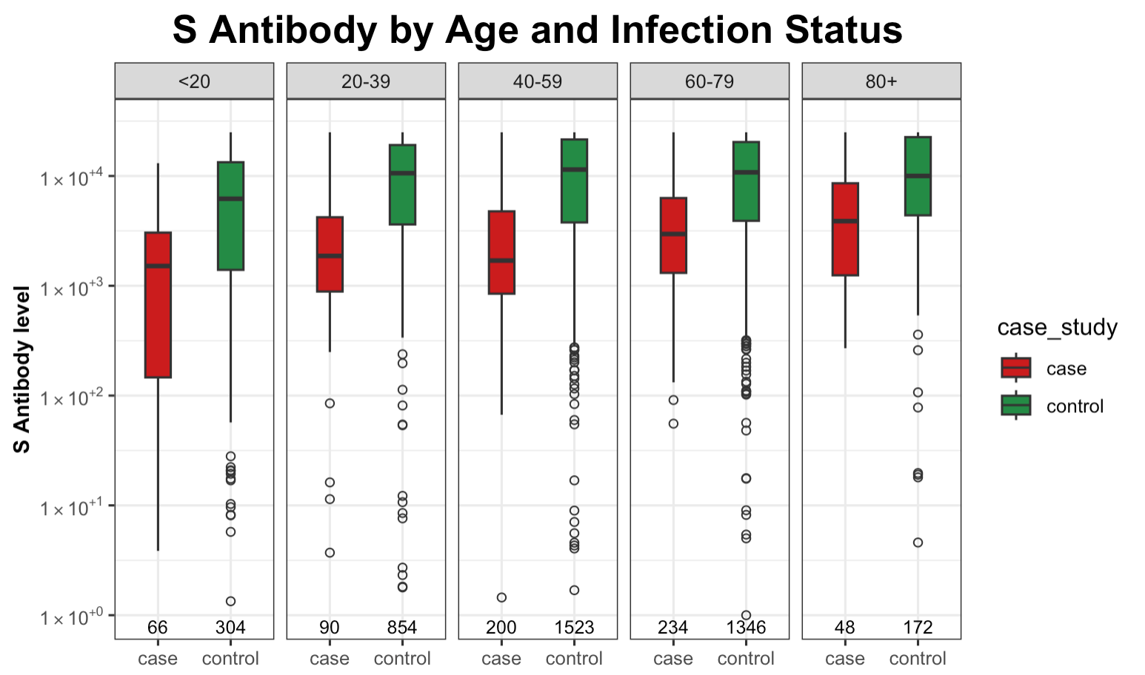
Figure2a: Box plot of S antibody levels, grouped by Age
Whatever the age group, the average S antibody level of objects with infection between 1st and 2nd survey is obviously
lower than those without infection
Notes:
Take more time one by one and slow
Younger group infected have higher variation, why younger infected population…

Slide 6
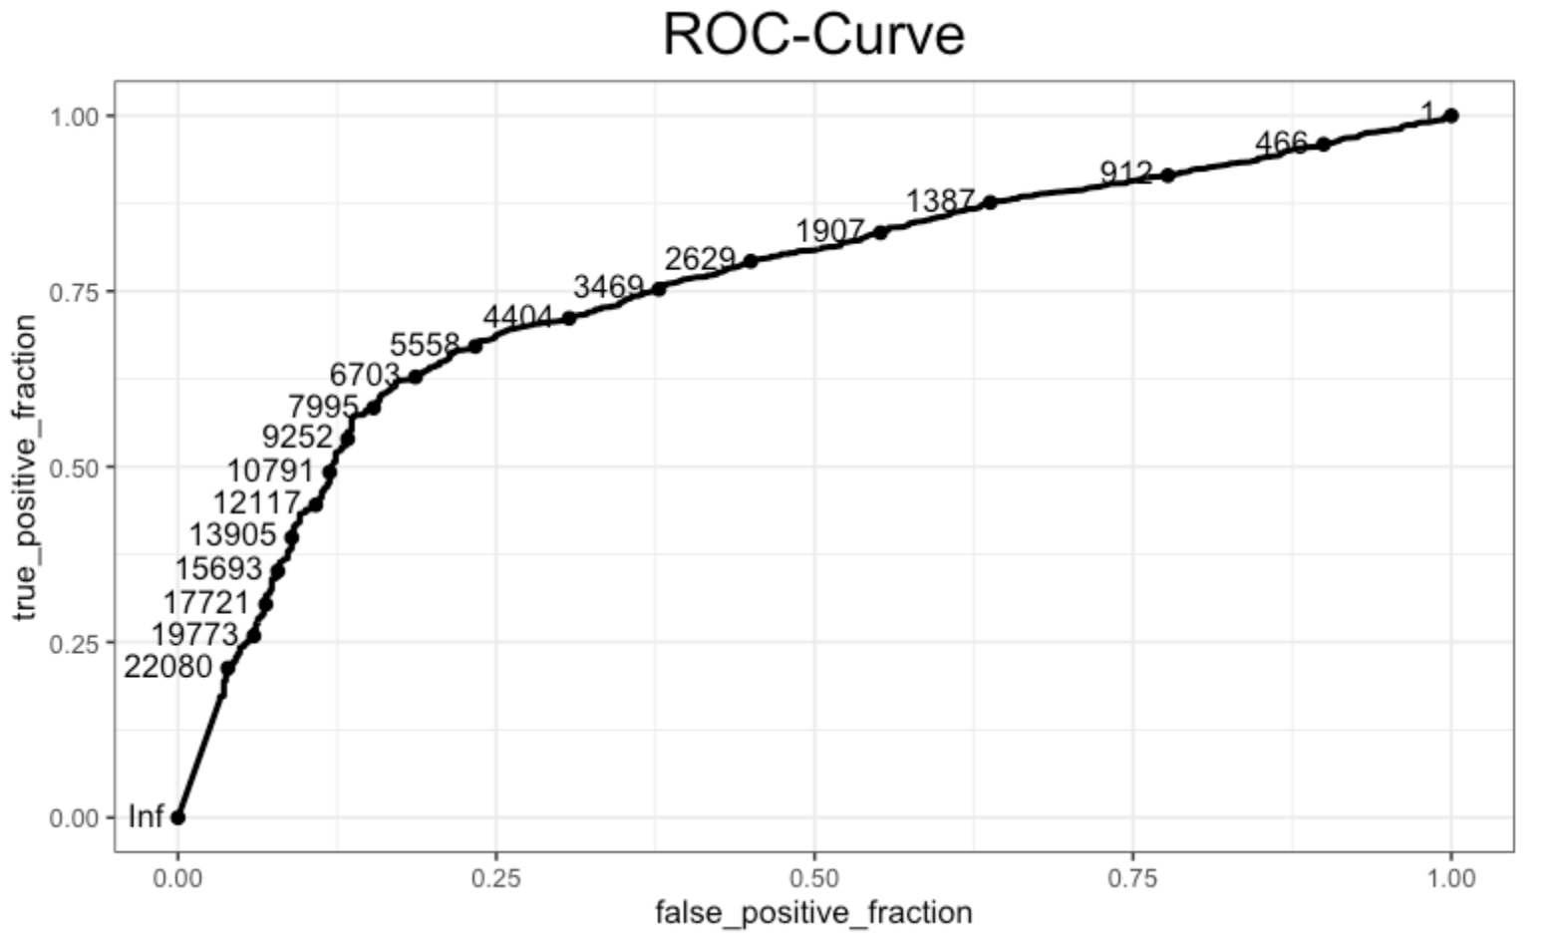

Slide 7
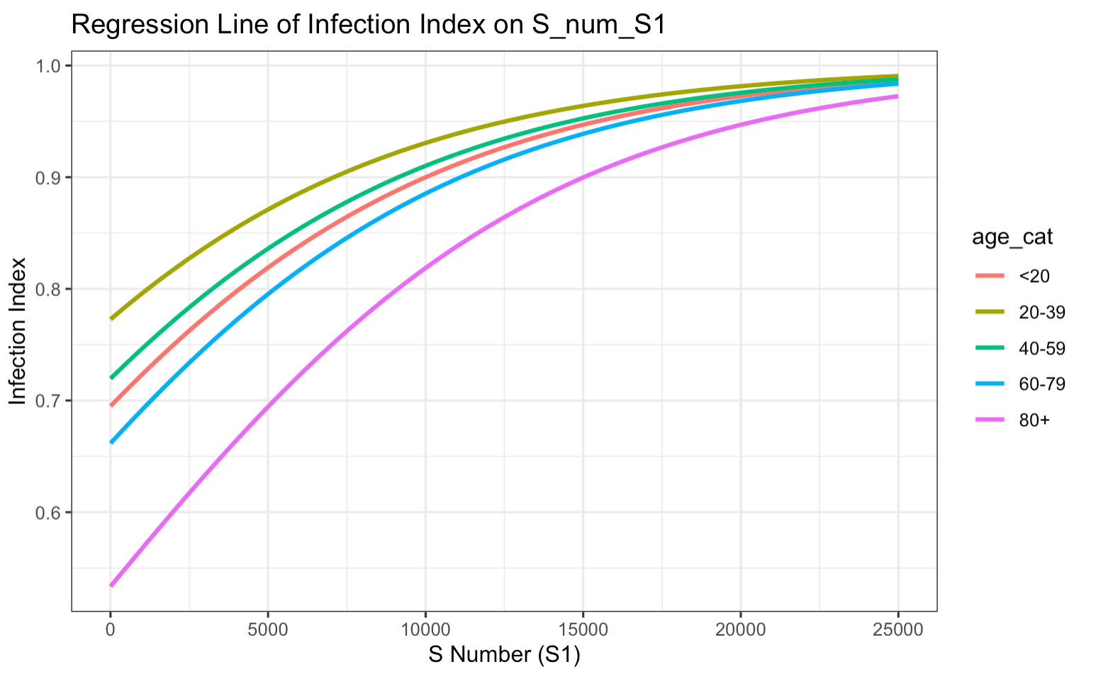
Regression Model Plot

Slide 8
Discussion
Summary:
Group I descriptive analysis indicated higher S antibody levels in uninfected individuals, and logistic regression showed that Spike (S) antibody thresholds for a 75% chance of avoiding COVID-19 infection are 6000, 8000, and 10000 for age groups <30, 30-60, and >60, respectively.
Group II analysis revealed there was no clear relationship between Spike antibody level and the severity of COVID-19 symptoms.
Population S antibody level threshold can guide appropriate vaccination interval by age group.
The association between S (spike) antibody levels and the severity of symptoms in individuals infected with COVID-19 shows a complex relationship between the immune response and disease outcomes→ While higher levels of S antibodies, especially those capable of neutralizing the virus, are generally associated with a more severe initial presentation of symptoms (Sancilio A et al, 2022), they may also indicate a more effective immune response.
Limitations:
Symptom levels can be a wide range but our study data is limited to binary information (Yes/No).
Spike antibody level can not explain the neutralizing antibody, which could be a better predictor for symptom severity.
Small sample size for those who are infected and asymptomatic individuals, making it difficult to prove a statistically significant difference.
Longer duration nof follow up on RR may be warranted.

Slide 9
Reference
[1] https://ourworldindata.org/covid-vaccinations
[2] Amjadi, M. F., & O'Connell, S. E. (2021). Specific COVID-19 symptoms correlate with high antibody levels against SARS-CoV-2. *AAI*.
[3] Imai, K., Kitagawa, Y., Tabata, S., Kubota, K., Nagura-Ikeda, M., Matsuoka, M., Miyoshi, K., Sakai, J., & all authors. (2021). Antibody response patterns in COVID-19 patients with different levels of disease severity in Japan. *Journal of Medical Virology*.
[4] Goldblatt, D., Fiore-Gartland, A., Johnson, M., Hunt, A., Bengt, C., Zavadska, D., Snipe, H. D., Brown, J. S., Workman, L., Zar, H. J., Montefiori, D., Shen, X., Dull, P., Plotkin, S., Siber, G., & Ambrosino, D. (2021). Towards a population-based threshold of protection for COVID-19 vaccines. *Vaccine*.

Slide 10
Appendix

Slide 11
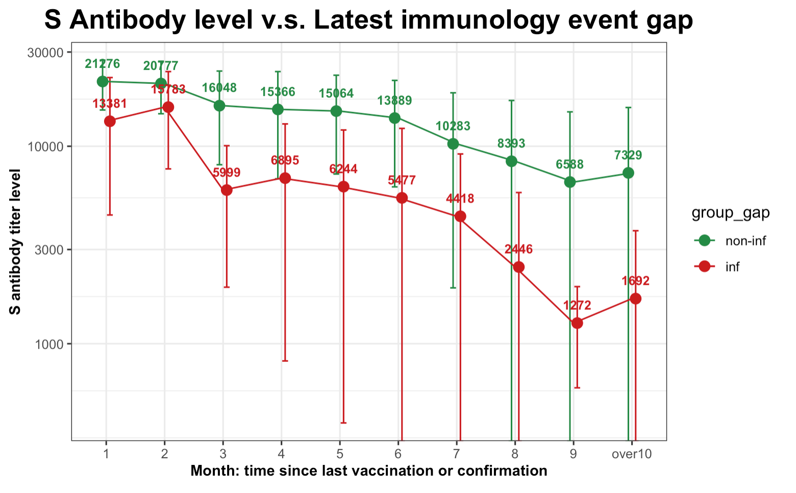
Figure2b: Line plot of S antibody levels versus latest immunological gap
10^{4.5}
Update the plot
10^{4.0}
10^{3.5}
10^{3.0}
Whatever the most recent immunological gap, the average S antibody level of objects without infection is obviously
higher than those with infection; Additionally, as the most recent immunological gap goes on, the median S antibody
level goes down
Notes:
Include another stratified analyses by age
Longre

Slide 12
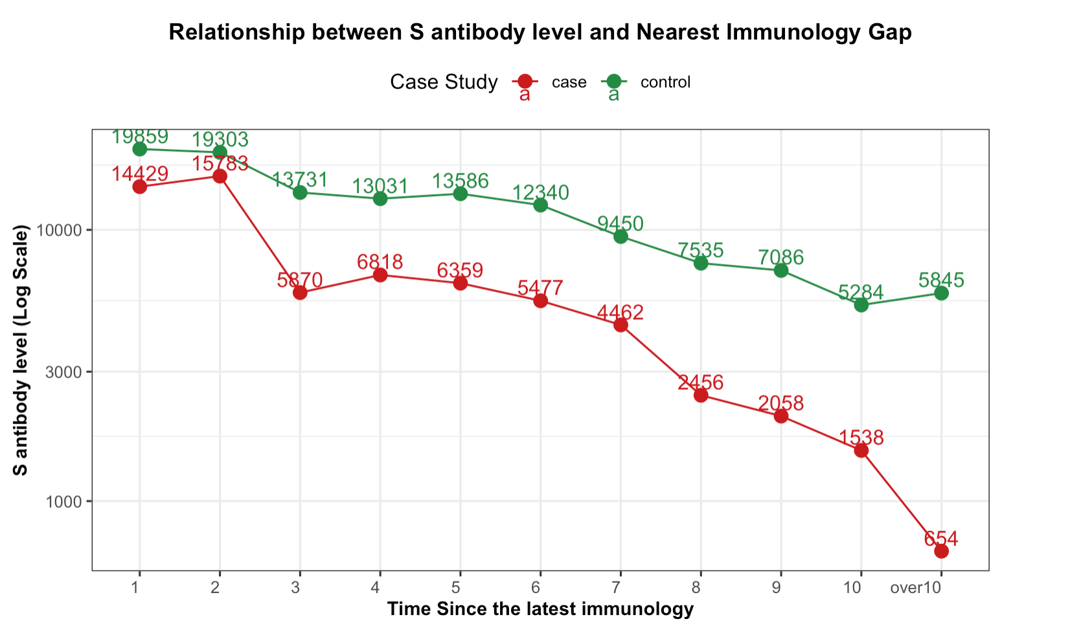

Slide 13
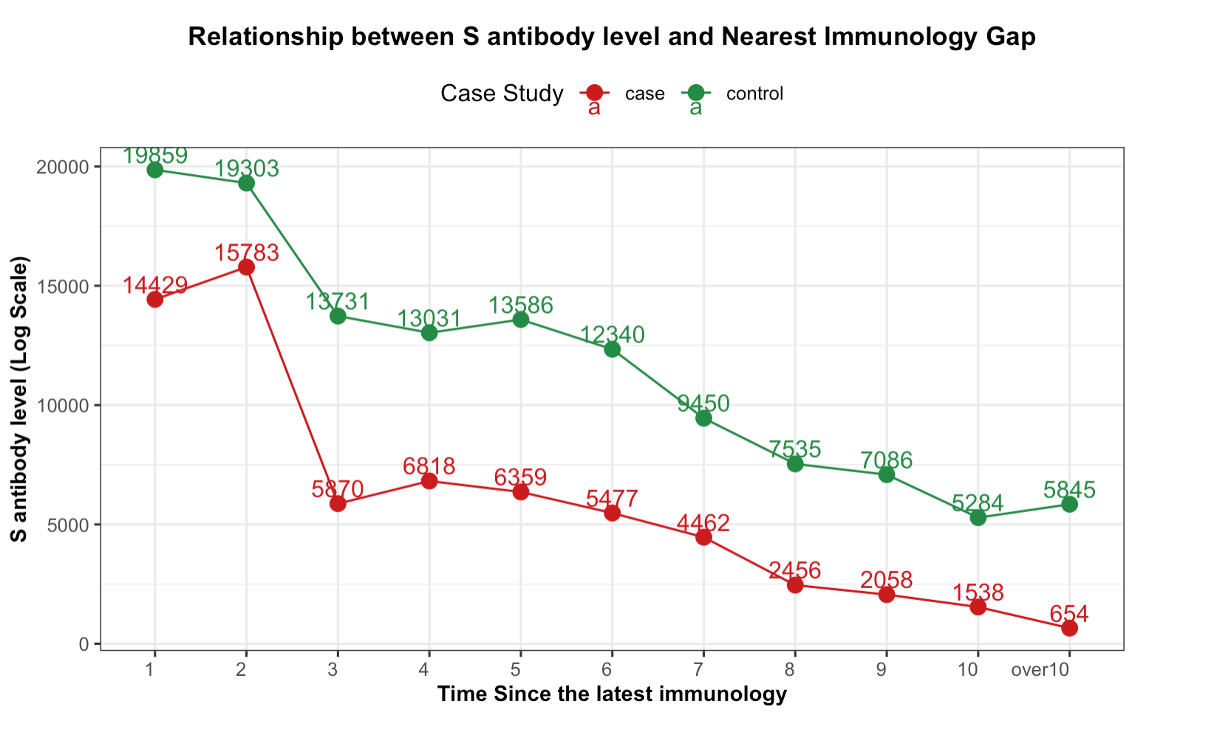

Slide 14
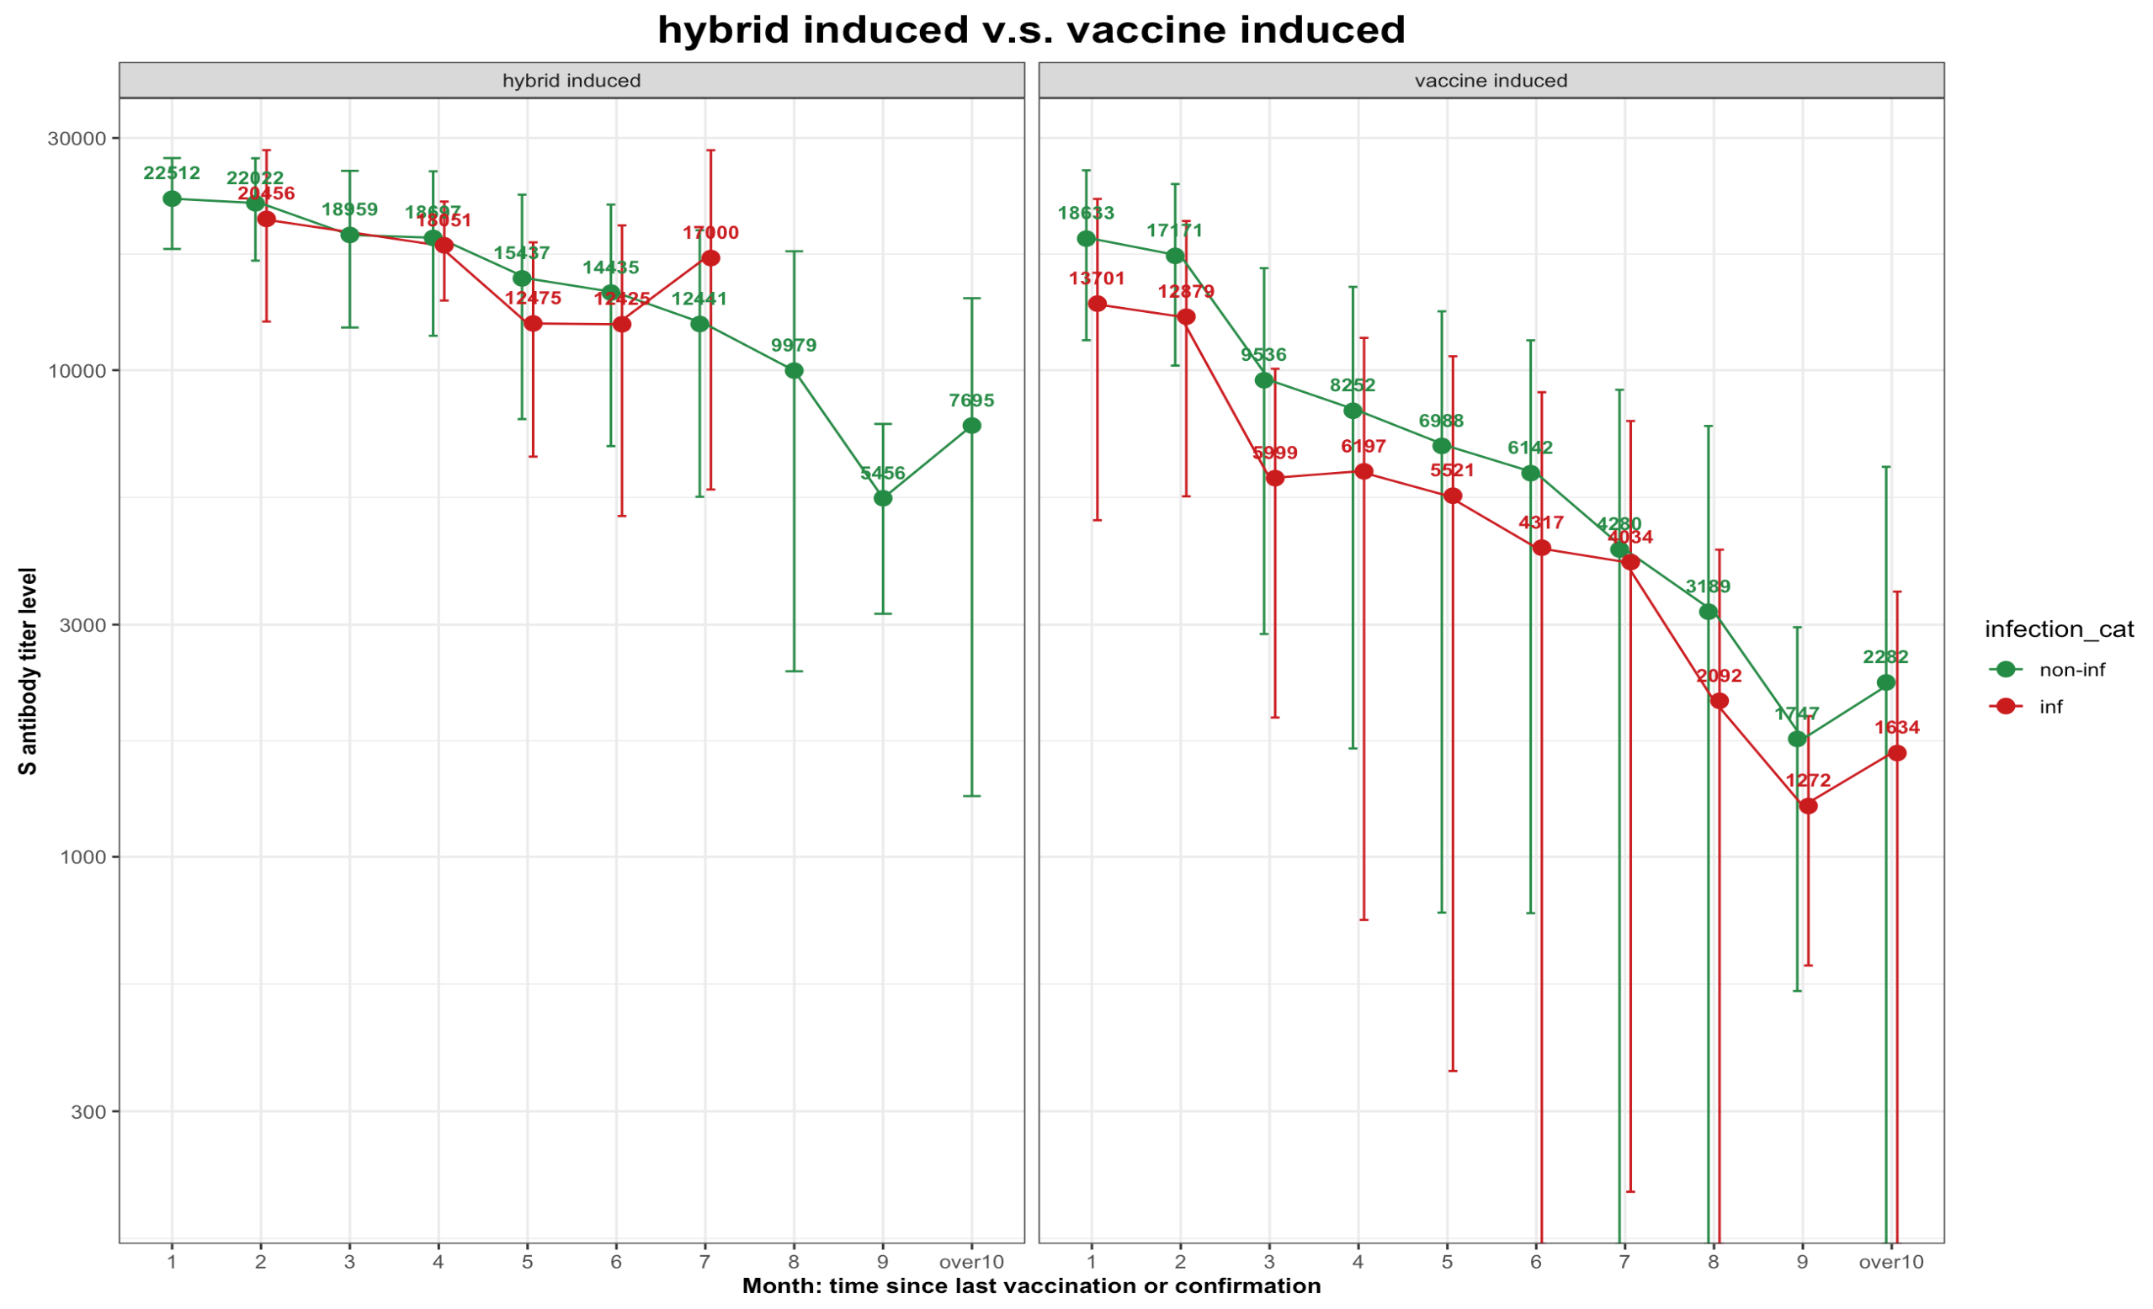
Figure2c: Line plot of S antibody levels versus latest immunological gap, grid wrapped by hybrid induced(A) and vaccine induced group(C)
10^{4.5}
Three panels
Total
Hybrid induce
Vaccine
…
10^{4.0}
10^{3.5}
10^{3.0}
10^{2.5}
Notes:
Draw this as survival curves…? Between hybrid vs vaccined induced group or age groups? Underlying diseaess?
OR by hybrid or not, age, S ab level , time since last immu, underlying diseases, region??– draw this as forest plot?
새로운 안경을 끼게 해준 연구, 발견, 스터디, 수업

Slide 15
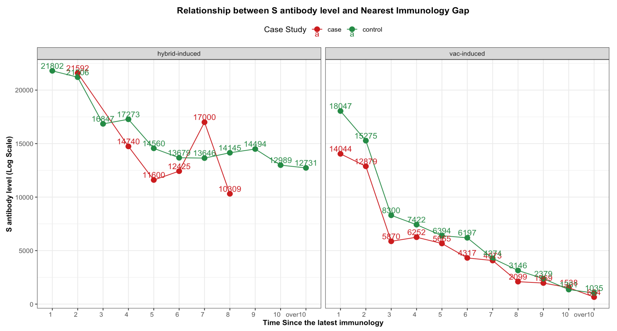
Put the total on the left side

Slide 16
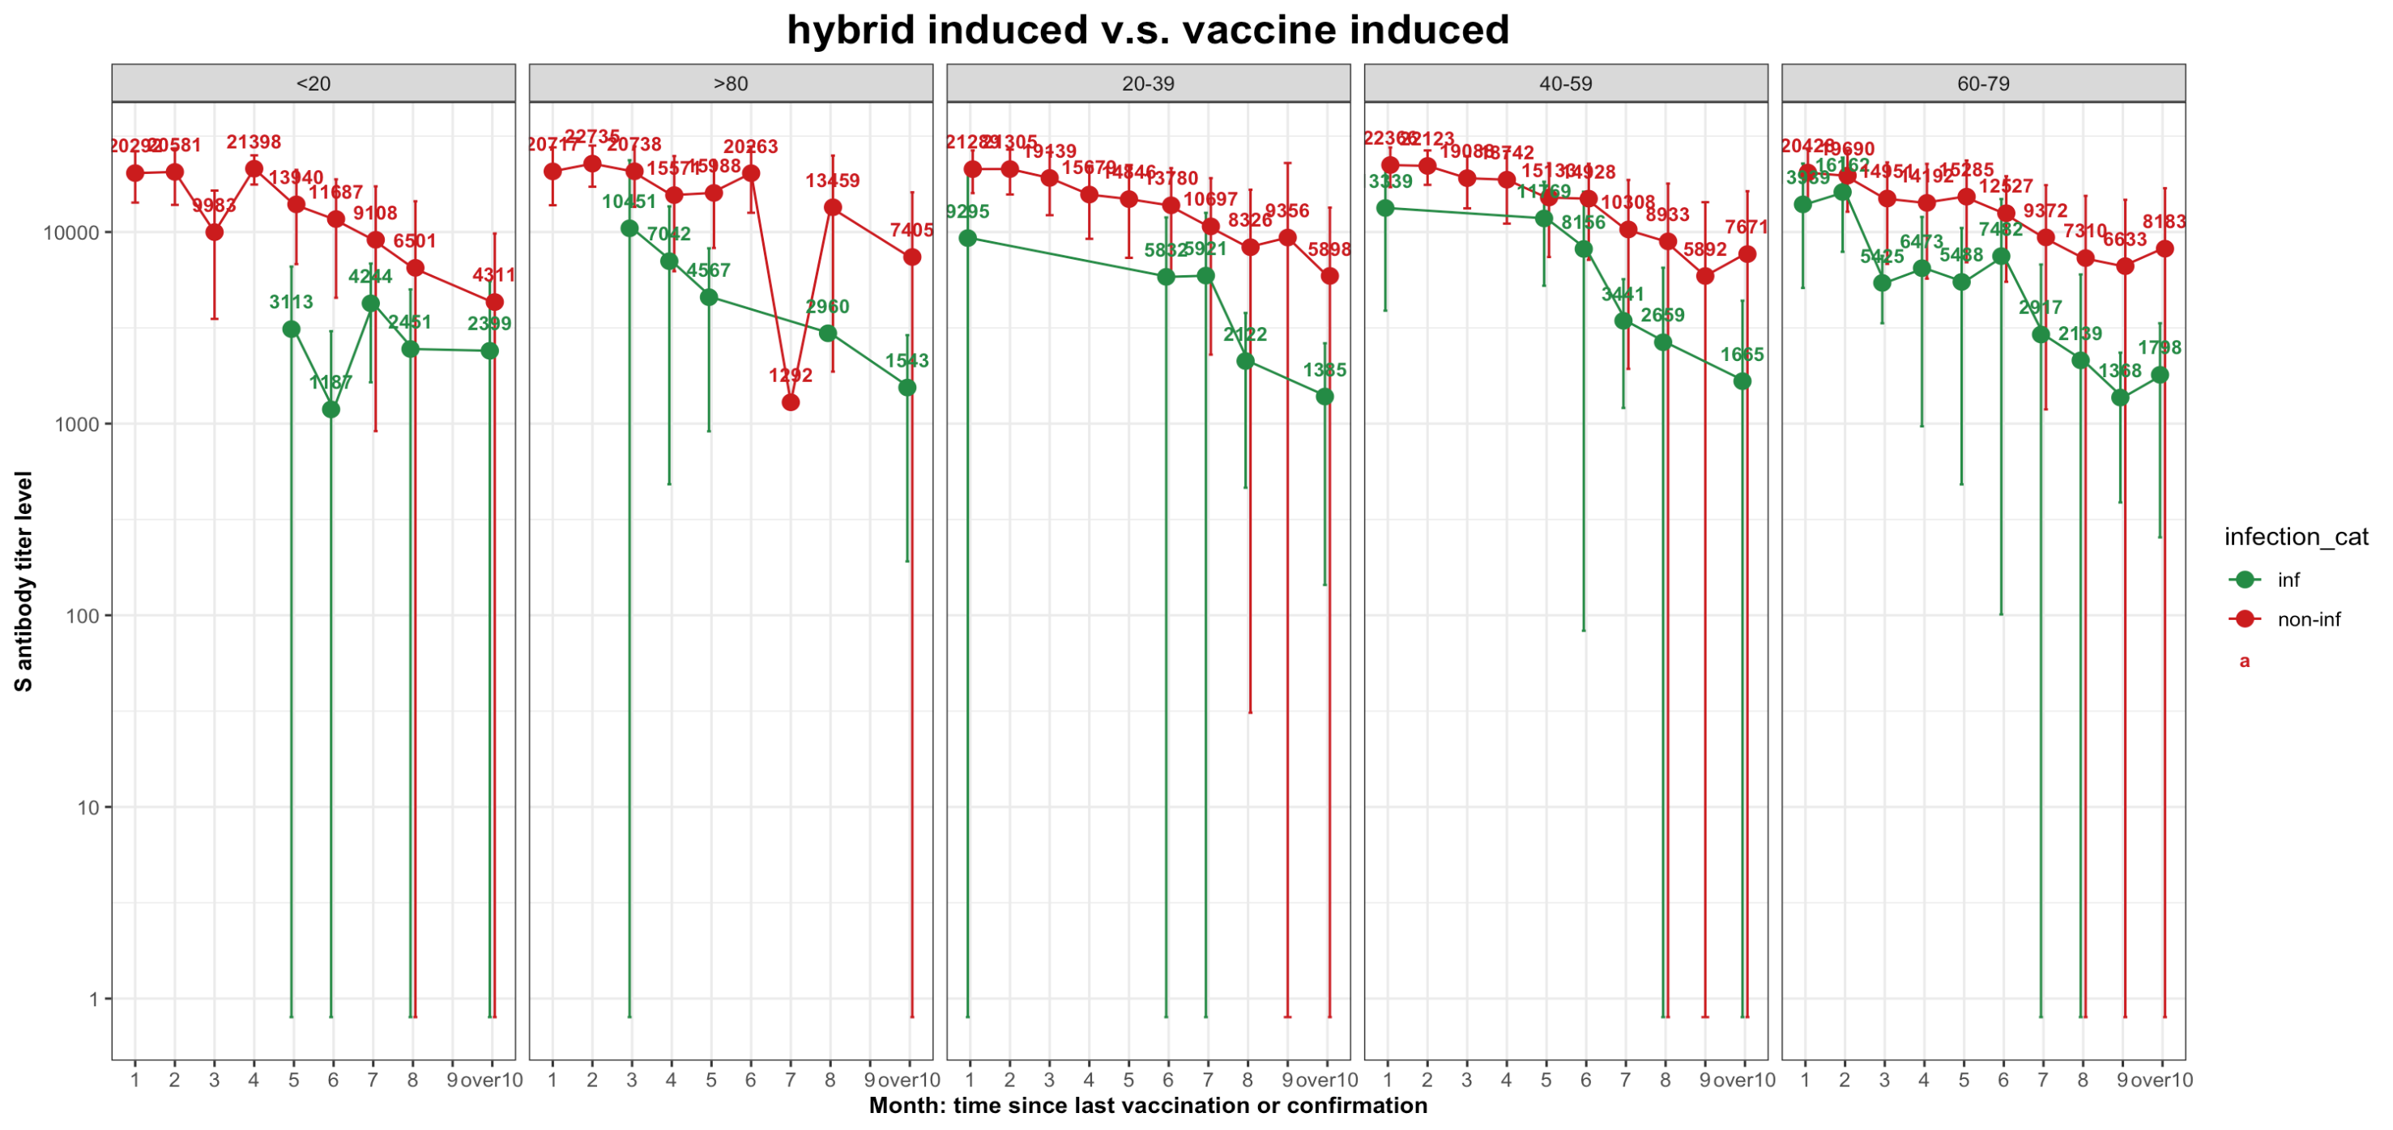

Slide 17
Summary:
Group I descriptive analysis indicated higher S antibody levels in uninfected individuals, and logistic regression showed that Spike (S) antibody thresholds for a 75% chance of avoiding COVID-19 infection are 6000, 8000, and 10000 for age groups <30, 30-60, and >60, respectively.
Group II analysis revealed there was no clear relationship between Spike antibody level and the severity of COVID-19 symptom.
Compared to the study by Imai, K. and Kitagawa, Y., Japan 2021^{[3]}, our research focused on collecting Spike antibody levels from patients exhibiting a range of COVID-19 symptom severities. This approach, distinct from utilizing immobilized recombinant S protein, clarifies the link between anti-Spike antibodies, COVID-19 infection rates, and symptom severity.
Contrasting with the study conducted by David Goldblatt in 2022^{[4]}, our research establishes a protection threshold based on total anti-Spike antibody levels, as opposed to focusing solely on IgG. This approach offers a unique perspective in determining the protective correlate, providing a broader understanding of immunity.
Limitations:
The dataset shows that the group of confirmed infections identified between the first and second surveillance points, especially among asymptomatic individuals, is small, making it difficult to prove a statistically significant difference.
Future efforts should concentrate on integrating data from the third surveillance to enhance the cohort's comprehensiveness.

Slide 18
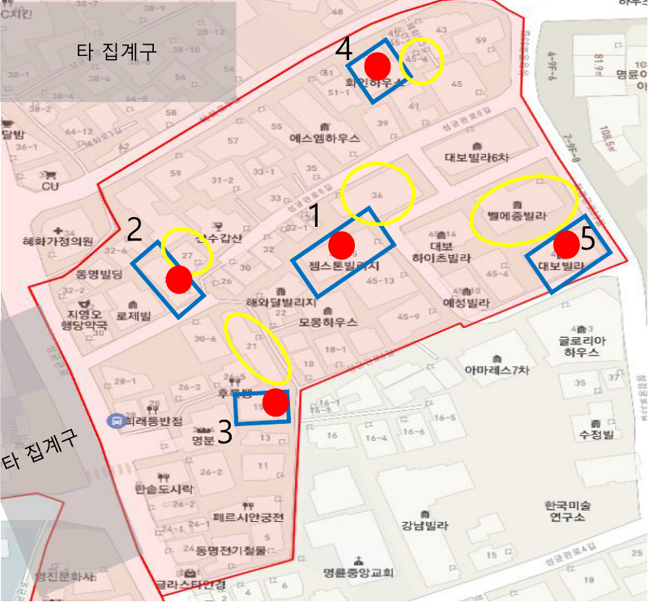
Selection criteria for main and reserve households in the aggregate premises
Aggregate Sphere
At least 2 assignments per region
(*Depends on the number of goals per region)
Main Furniture
Randomly selected by Global Research 5 Pattern Furniture
If this household declines consent or is unsuitable, spare furniture is designated in a counterclockwise spiral upon the surveyor's request, approved by the survey manager.
Spare Furniture

Slide 19
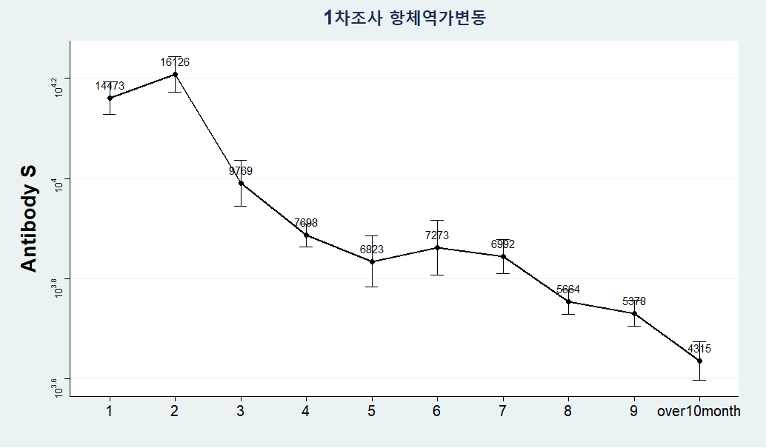
Trend of Decreased Antibody Titers Among Participants in the Follow-Up Survey (Total, 9,007 individuals)
Blood Collection Date – Last Vaccination Record or Date of Confirmation

Slide 20
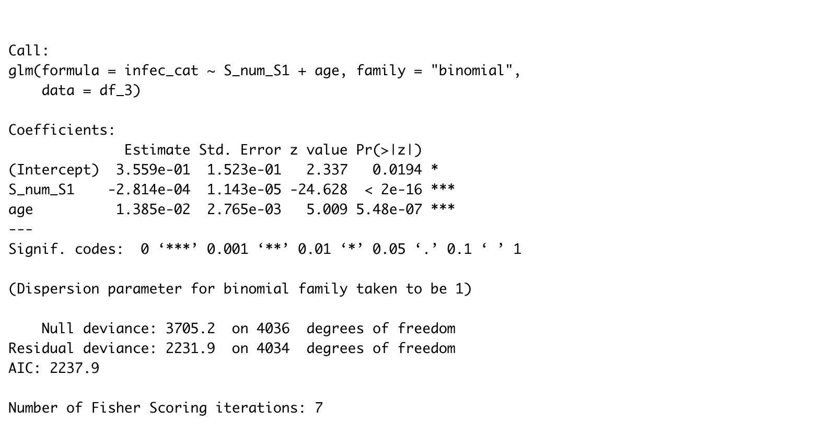
Regression Model
Both ”S_num_S1” and “age” are significant here

Slide 21
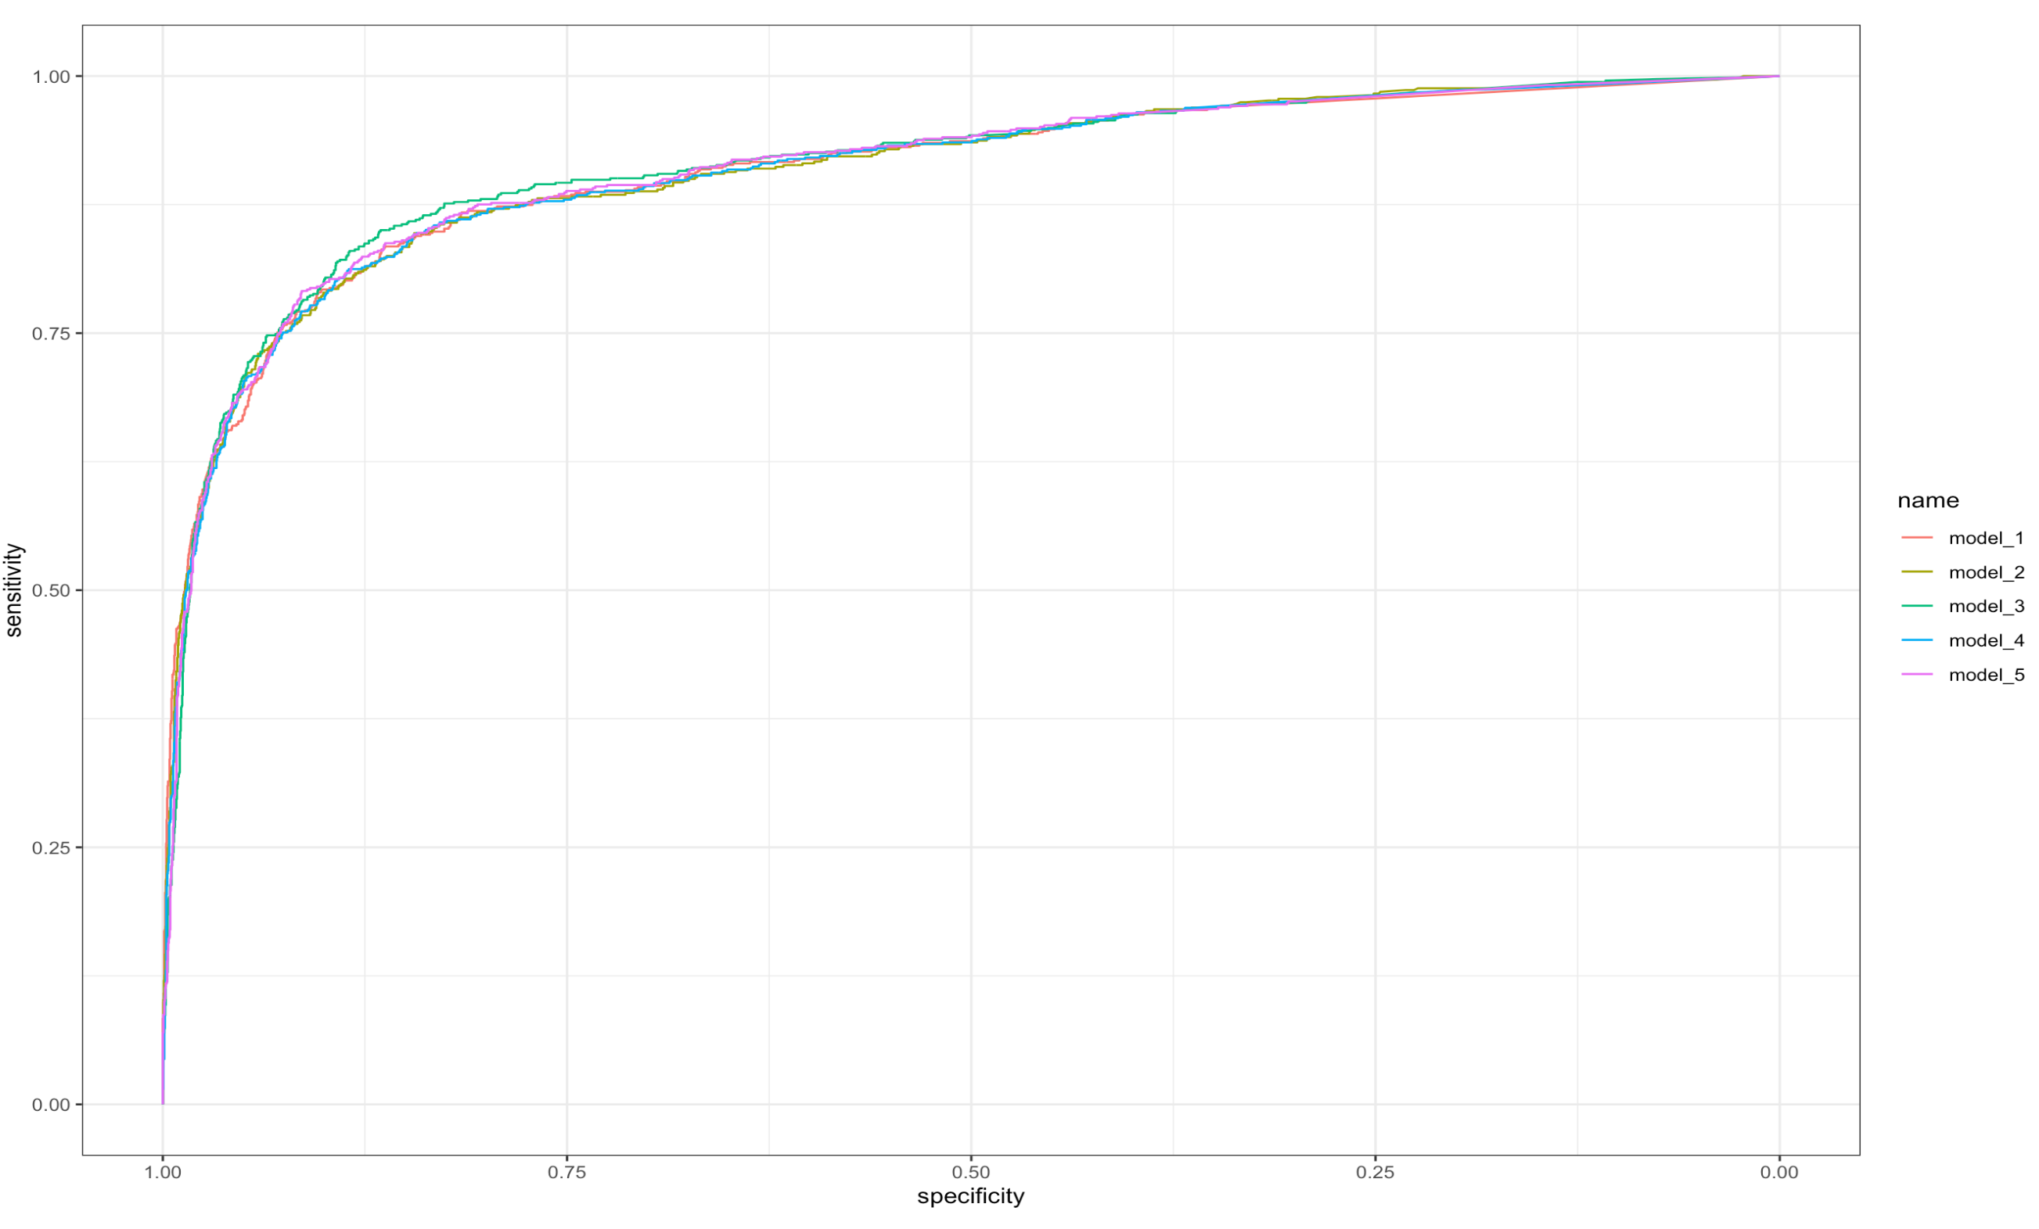
Regression Model comparison
Infec ~ S_num
Infec ~ S_num + Income
Infec ~ S_num + Age
Infec ~ S_num + Otherdisease
Infec ~ S_num + edu

Slide 22
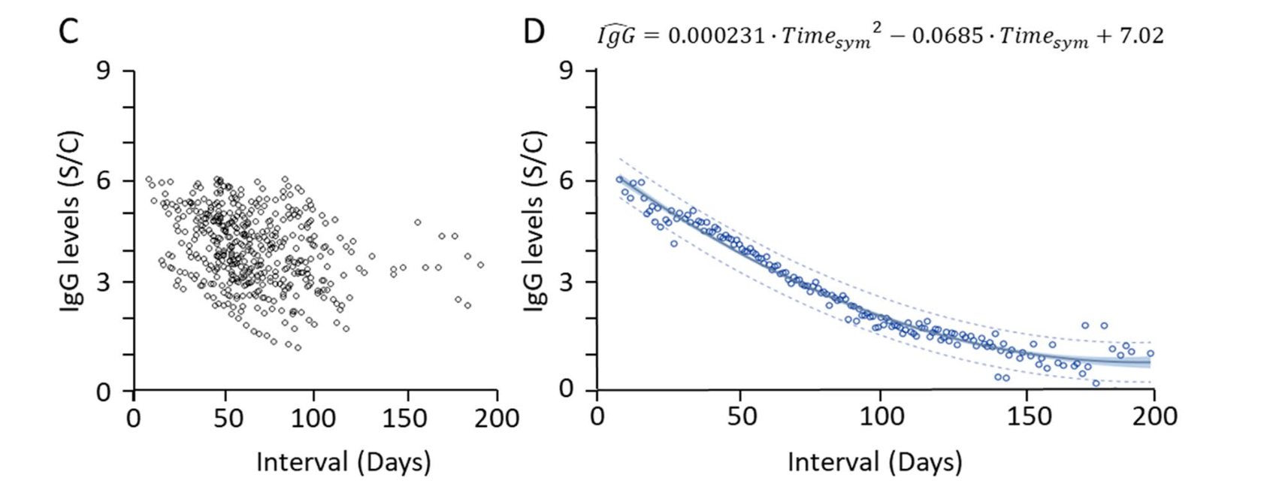
Topic: If S antibody level contribute to COVID-19 symptoms ?
What do we currently have ?
S Antibody Level
Symptomatic/Confirmed
Asymptomatic/Confirmed
UNKNOWN
with Decay
*
1st survey
2nd survey
contagion
V
vaccine
V
*
*
Date of latest vaccination
Date of Confirmation1
1) Date of Survey1
2) S Antibody level of Survey1
3) IF any Symptom before
Date of Confirmation2
1) Date of Survey2
2) S Antibody level of Survey2
3) IF any Symptom before
UNKNOWN
DOI: 10.1038/s41598-021-96171-4

Slide 23
DATA PREPROCESSING
S Antibody Level
Symptomatic/Confirmed
1st Case
Asymptomatic/Confirmed
V
vaccine
V
2nd Case
EXCLUDE
V
3rd Case
4th Case
EXCLUDE
V
5th Case
V
Aug 2022
1st survey
Dec 2022
2nd survey

Slide 24
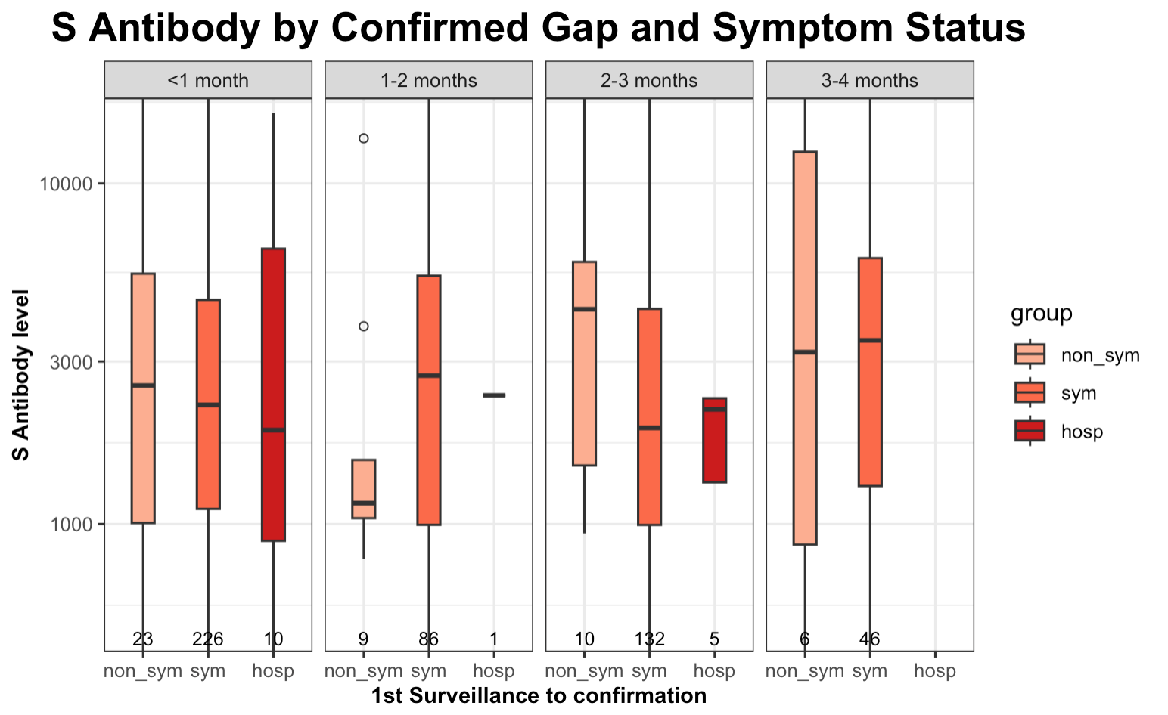
Figure3b: Box plot of S antibody levels, grouped by Post time
Excluding the non-representative group (1-2 months) due to extremely low sample sizes, once the gap between the first surveillance and confirmation is accounted for, individuals with higher S antibody levels are less likely to exhibit severe symptoms.
10^{4.0}
10^{3.5}
10^{3.0}

Slide 25
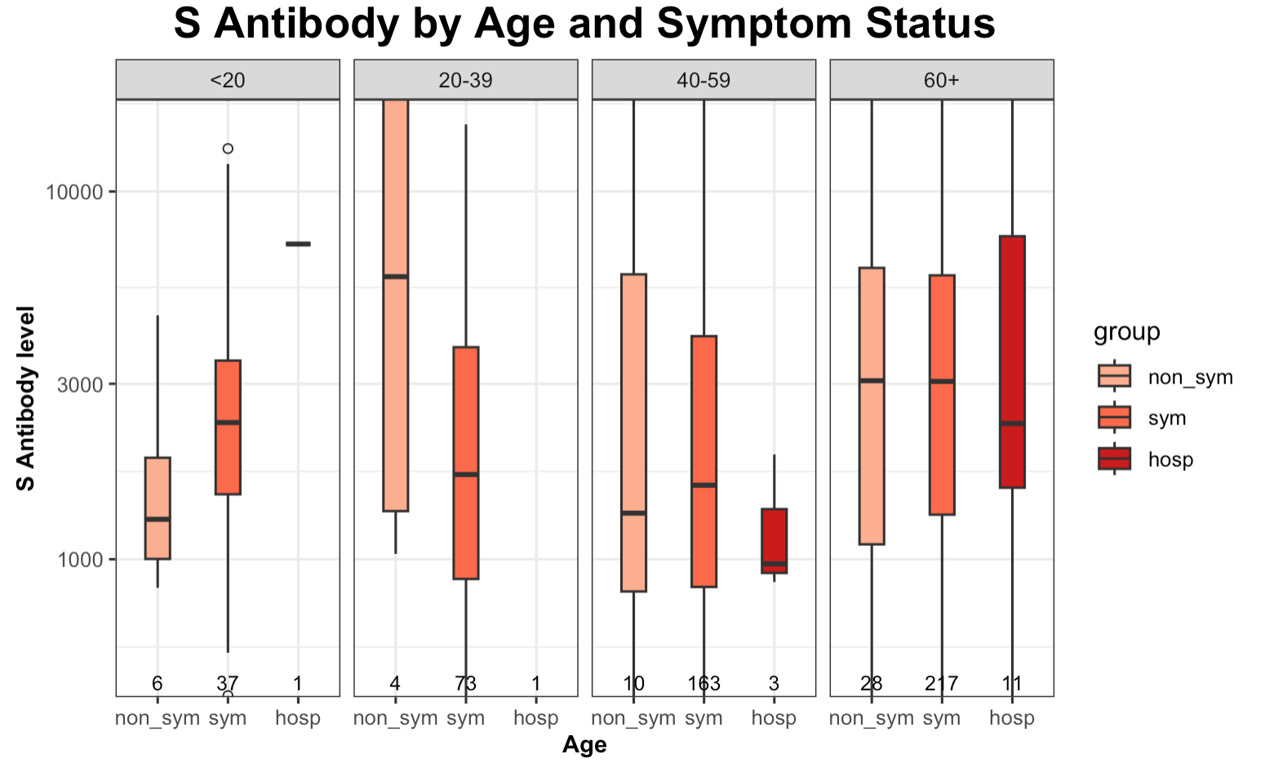
Figure3a: Box plot of S antibody levels, grouped by Age
Overall, the sample sizes for asymptomatic groups, particularly those under 60, are quite small. Regarding the older age group, individuals with higher S antibody levels tend to exhibit fewer symptoms.
10^{4.0}
10^{3.5}
10^{3.0}

Slide 26
Other cases needed to be carefully considered ?
1st Case
EXCLUDE
V
V
2nd Case
EXCLUDE
V
1st confirmation
- Symptomatic!
1st Survey
- IF any Symptom before?
- Yes
2nd confirmation
- Asymptomatic ?
- Symptomatic?
2nd Survey
- IF any Symptom before?
- Yes

